Slide 1
ALLAN WHITE
Khristu munyimbo # 154.
Mlonda ,Tandiuze Ine

Slide 2
ENJOY YOUR HEALTH.
Time to wake up !!!
God's final call.

Slide 3
1 Thessalonians 5:9 ( NKJV) '' for God did not appoint us to wrath,but to obtain salvation through our LORD JESUS CHRIST."

Slide 4
1 Thessalonians 5:9 ( NKJV) '' for God did not appoint us to wrath
- Mulungu sanatilenge ife kuti tizaone mkwiyo wake kapena kuti tikumane ndi matenda ndi matsoka.
-Mulungu akufuna kuti tizapulumuke.
-Mavuto omwe tikukumana nawo monga matenda, imfa, ngozi,njala ndizina zotere chifukwa cha uchimo.
- Mulungu amatifunila zabwino.

Slide 5
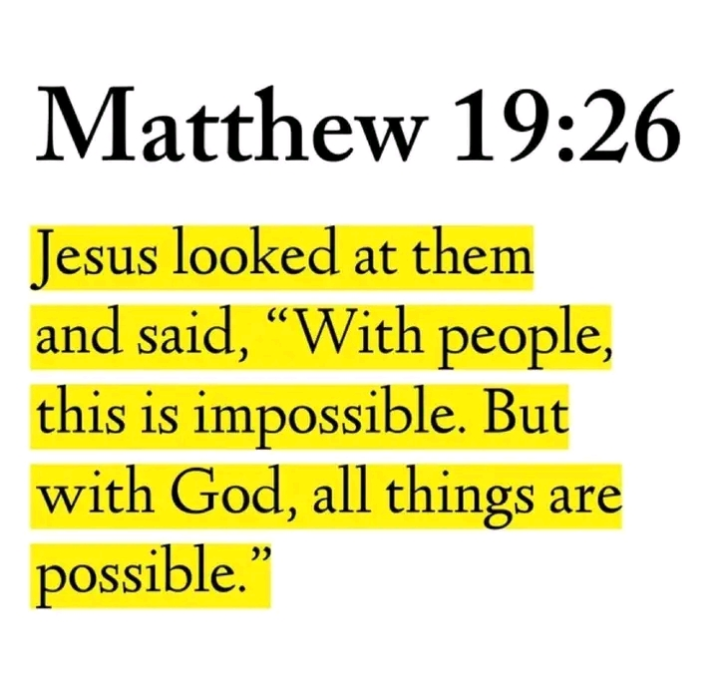
Yohane 3:16,17
Chikondi cha Mulungu
Mulungu wabwino
Anakonda anthu a dziko lapasi
Chifukwa chokonda motere anapereka Mwana wake yekha
Kuti yense yokhala kwa iye akapulumusidwe.
Akufuna tonse tikapulumuke
Osatengela maonekedwe athu, maphunziro kapena chikhalidwe chathu.

Slide 6
ZILONDA ZA PAKHOSI
Anthu ochuluka akusautsika ndi zilonda zapakhosi ( sorethroats)Ana komaso akuluakulu.
Ambiri saziwa chomwe chimayambisa komaso saziwa zoti achite akapezana ndi mavuto oterewa.

Slide 8
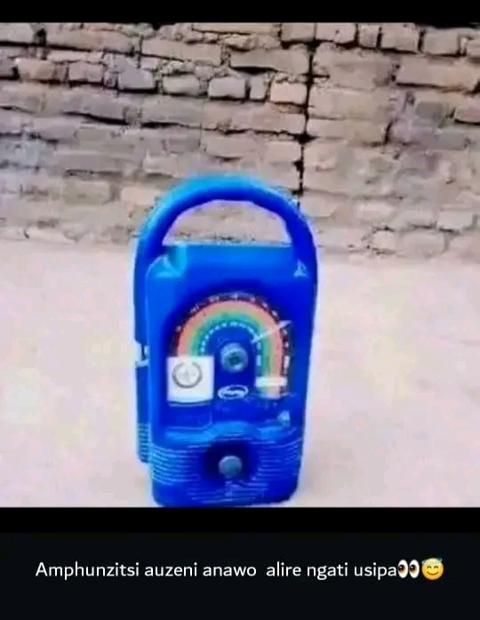
ZOMWE ZIMAYAMBITSA.
Tione zomwe
ZIMAYAMBITSA
Vuto la zilonda
Zapa khosi.
Chiyambi chake
Chotani??

Slide 9
THE CAUSES OF SORETHROATS.
Ma bacterial ndima virus ndi omwe amayambitsa vutori.
Kulankhula mokuwa
Kukhosomola kwa nthawi yaitali
Utsi otuluka muma engine
Zakumwa kapena zakudya zotentha kwambiri
Kusuta fodya

Slide 10
ZOYAMBITSA
Bacteria amene amapezeka pa mswachi.
Being allergic to certain diet.
TREAMENT YAKE NJOTANI?

Slide 11
TREATMENT
Madzi a ndimu ndi uchi ( kudya uchi/ phatikizani madzi a ndimu komaso uchi ndi kumwa pang'ono.
Madzi otentha koma ikani mchere pang'ono( katatu pa tsiku)
Imwani flaxseed ( amathandiza kuthesa zilonda za pakhosi)

Slide 12
TREATMENT
Imwani madzi oyikamo cayenne pepper 🌶️, koma asakhale wochuluka cayenne chifukwa amawawa kwambiri.( Kawiri patsiku)
Towel yonyowa ndi yowuma.Nyikani towel m'madzi ozizira ndipo muyizungulize khosi lanu kawiri kapena katatu kutengela kukula kwa towel kenako tengani towel ina yowuma muyike pamwamba pake ndipo muyichotse m'mawa.( Pangani izi pogona)
Ikani mapazi anu m'madzi ofunda ( lukewarm water) kwa phindi khumu( 10 minutes)

Slide 13
YESAYA 45:22
Yang'anani kwa ine kuti mupulumutsidwe inu malekezero onse adziko; pakuti ine ndine MULUNGU, palibe wina.
Mulungu ndiye wopulumutsa ndi wochiza nthenda zonse( masalmo 103:3)
Yehova ndiye sing'anga wamkulu ( Exodus 15:26)

Slide 14
KUMBUKIRANI IZI !!!!
Satirani ndi kusunga malamulo onse a nthazi.
Kudya zakudya zopasa nthazi
Kuchita masewero olimbitsa thupi
Kupewa machitidwe woipa
Kukhulupilira Mulungu nthawi zonse
Kumwa madzi ambiri mu nthawi yake
Kupuma mphweya wa bwino

Slide 15
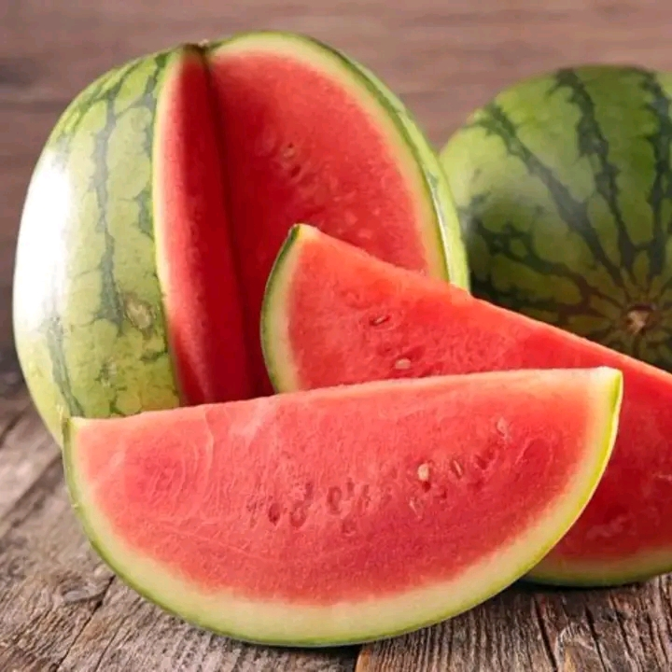
Idyani mwa
nzeru.

Slide 16
- kupumula ukagwira ntchito -kukhala pa dzuwa m'nthawi Yoyenera.
Ambuye akudaliseni nonse.
By :ALLAN WHITE.

